Slide 1
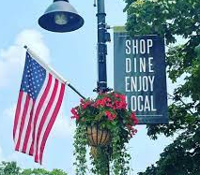
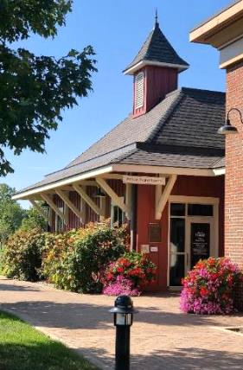






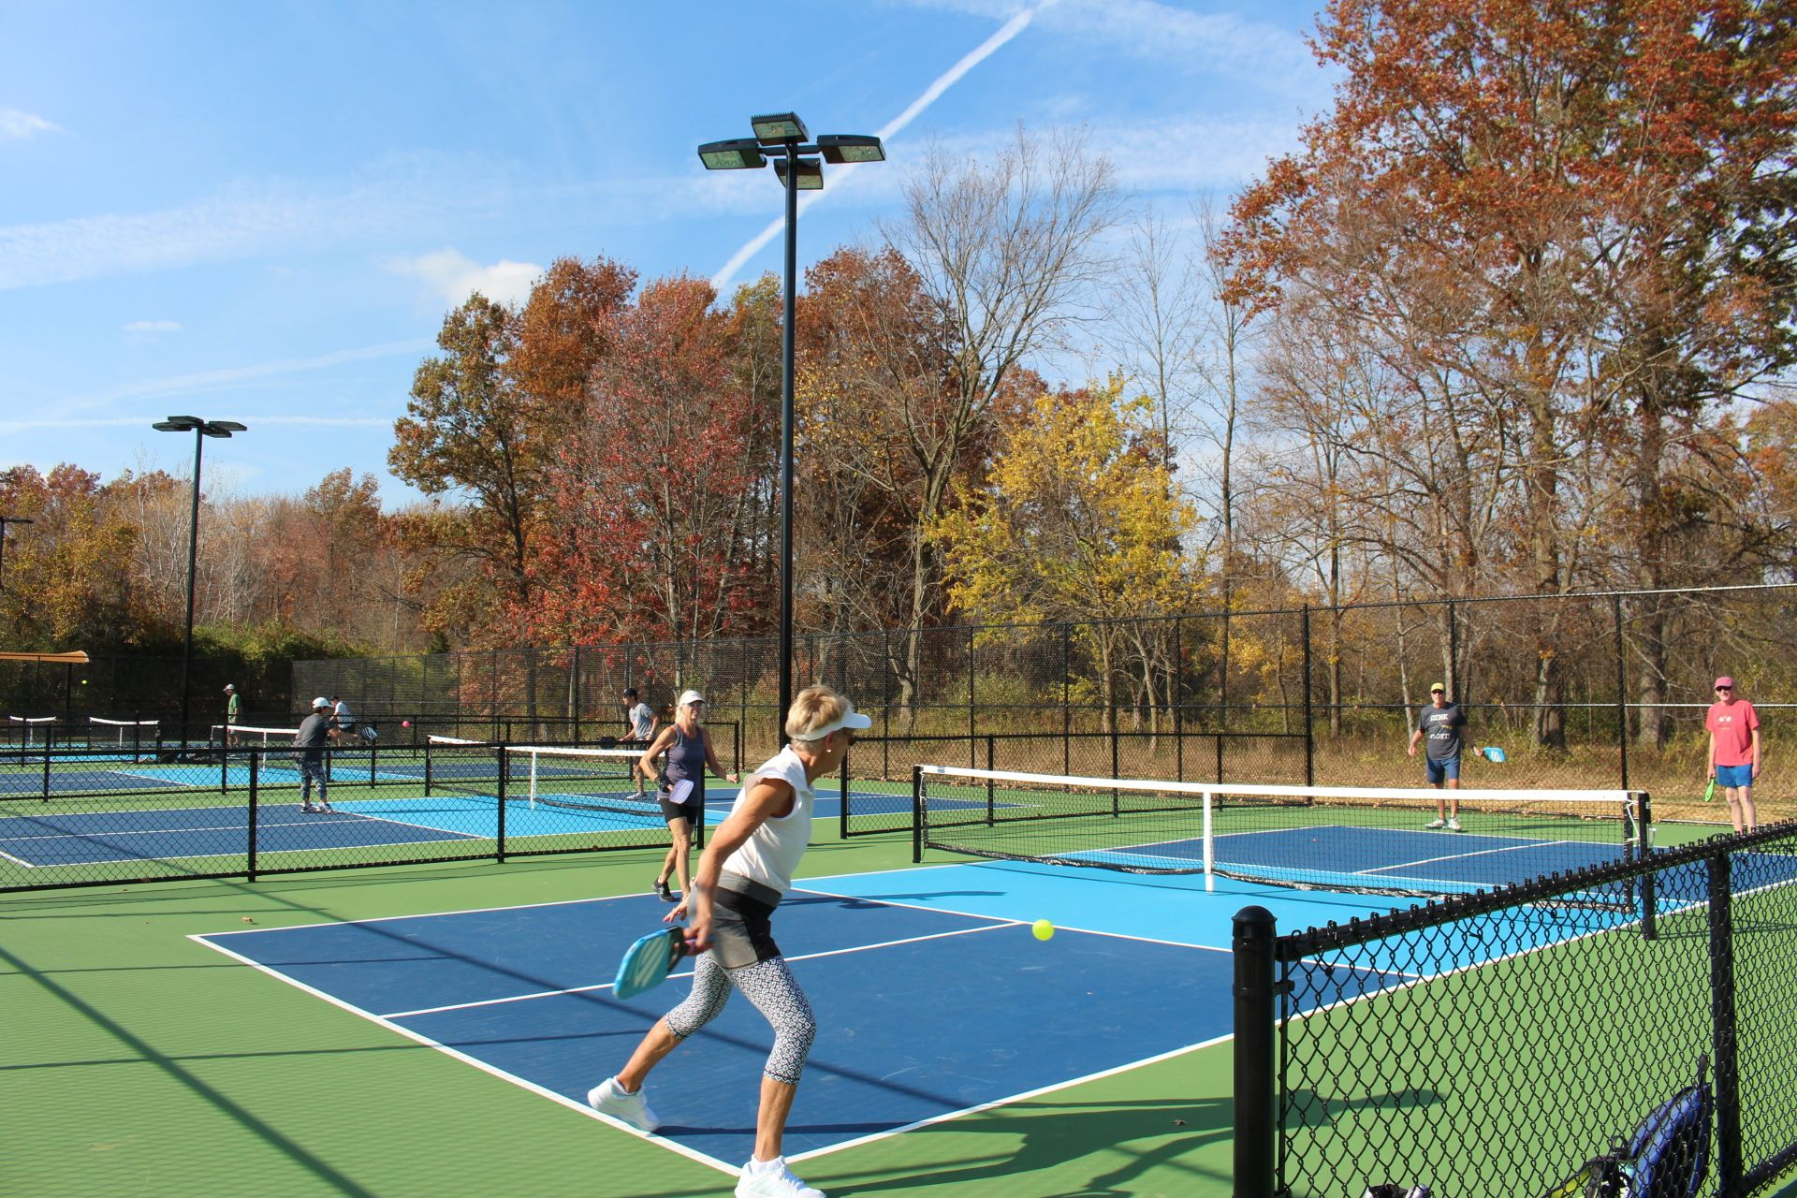
6/23/25
City of Powell
Community Attitudes Survey
Saperstein Associates, Inc. / 2025

Slide 2
.
  This research gives residents of Powell a voice.
  It allows them to express opinions on myriad issues, and, in doing so, provides city officials important
  data as planning for the future continues.
  Similar studies were conducted in
  2008, 2010, 2012, 2014, 2016, 2018, 2021, and 2023.
2

Slide 3

Methodology

Slide 4
….
  Data were collected using two methodologies: telephone interviews and an online questionnaire.
  Each methodology produced data for roughly half the sample, yielding a total of 421 Powell residents who participated.
  The Margin of Error for this survey is ≤±5 percentage points at the 95 percent level of confidence.
  The sampling frame (i.e., the lists of residents from which the sample was drawn) included files provided by the City of Powell and a firm with an exper-tise in sample development. Each source included both registered voters as well as residents not registered.
  Data were collected from April 23 to May 22, 2025.
4

Slide 5
…
  The telephone interviews averaged 17 minutes in length; the comparable figure for the online participants is 13 minutes.
  To compensate for limitations in the data-collection process, the combined file of respondents was weighted on key demographics to better reflect known population parameters.
 | Actual* | Survey†
White | 82% | 84%
Asian | 10% | 10%
Hispanic | 2% | 2%
Black | 1% | 1%
Other | 5% | 3%
 | Actual* | Survey†
Younger than 35 | 11% | 11%
35 to 54 | 45% | 45%
55 to 64 | 19% | 19%
65 or Older | 25% | 25%
Male | 51% | 51%
Female | 49% | 49%
 |  |  | Phone^{ƚ} | Online†
 |  |  | 80% | 87%
 |  |  | 12% | 9%
 |  |  | 2% | 2%
 |  |  | 1% | 1%
 |  |  | 5% | <1%
 |  |  | Phone^{ƚ} | Online†
 |  |  | 19% | 2%
 |  |  | 47% | 44%
 |  |  | 16% | 22%
 |  |  | 18% | 32%
 |  |  | 52% | 50%
 |  |  | 48% | 50%
*SOURCE: U.S. Census Bureau, QuickFacts, 2024; American Community Survey, 2023 / †Data were weighted to reflect known population parameters.
5

Slide 6
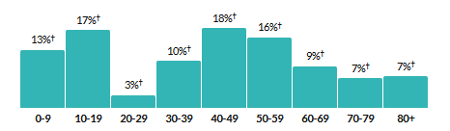
.
  The telephone interviews averaged 17 minutes in length; the comparable figure for the online participants is 13 minutes.
  To compensate for limitations in the data-collection process, the combined file of respondents was weighted on key demographics to better reflect known population parameters.
 | Actual*
Younger than 35 | 11%
35 to 54 | 45%
55 to 64 | 19%
65 or Older | 25%
Male | 51%
Female | 49%
Powell Population by Age Ranges^
*SOURCE: U.S. Census Bureau, QuickFacts, 2024; American Community Survey, 2023 /^ACS 2023 5-year estimates
6

Slide 7

Powell as a Place to Live

Slide 8
  .
More than four out of ten residents consider Powell an exceptional place to live. Almost everyone else considers the city better than average.
Little has changed since 2021.
As a place to live, Powell is …
2025
95%
2025
Exceptional
44%
2023
2025:
2023:
2021:
2018:
2016:
44%
42%
46%
51%
56%
2023
95%
2021
96%
2021
95%
2018
2018
95%
2016
2016
94%
2014
2014
97%
2012
2012
98%
Better
than average
51%
2010
95%
Disappointing
1%
2010
2008
Just okay
4%
2008
94%
0%
25%
50%
75%
100%
Better than average
Exceptional
Q5: All things considered, as a place to live, would you rate Powell exceptional, better than average, just okay, or disappointing?
8

Slide 9
  .
  .
Three out of four residents believe that Powell is heading in the right direction.
Though little has changed since 2016, the comparable figures were higher in 2014 and 2012.
Powell’s Direction
2025
77%
2025
Right direction
77%
2023
2023
77%
2021
2021
75%
2018
75%
2018
2016
2016
74%
2014
2014
80%
2012
2012
88%
2010
79%
2010
Wrong
track
20%
2008
2008
77%
0%
25%
50%
75%
100%
Not sure
3%
Right direction
Q6: As you look to the future, is Powell heading in the right direction or is it off on the wrong track?
9

Slide 10
  ..
For a plurality of residents, being a safe community is Powell’s most appealing attribute, replacing the city’s small-town atmosphere.
Since 2023
Safe
34%
(+4 pp)
Convenient location
22%
(0 pp)
Quality schools
21%
(+3 pp)
Small-town atmosphere
20%
(-10 pp)
Friendly residents
19%
(+4 pp)
Great parks
15%
(+8 pp)
Walkability / connectivity
14%
(*)
Like most about living in Powell
*Not mentioned previously
Q7: All things considered, what do you like most about living in Powell? (open-ended question)
10

Slide 11

Powell Police Department

Slide 12
  .
Two out of three residents described Powell’s police department as excellent. Nearly everyone else described it as good.
Powell Police Department*
“Powell is safe or feels safe. Powell police seem to be all around town.”
Excellent
66%
“The police are amazing, and they are so friendly with the kids.”
Good
29%
95%
“I like the police department and the safety and kindness they provide ...”
“I like feeling safe in my home and when I am walking. We have an exceptional police force.”
“I feel safe in my community because of the exceptional police ….”
Average
4%
“The police do a great job.”
Fair
1%
Poor
<1%
*New in 2025
Q20: How would you rate the overall agency performance of the Powell Police Department: excellent, good, average, fair, or poor?
12
Notes:
There is no direct comparison from 2018 for this question.

Slide 13
Most residents agree strongly that Powell’s police do a “good job” keeping neighborhoods safe; treat residents courteously, with dignity and respect; and are well-trained competent professionals.
Powell Police Department*
The Powell Police Department does a good job
keeping your neighborhood safe
97%
The Powell Police Department treats residents
courteously and with dignity and respect
91%
The Powell Police officers are competent,
well-trained professionals
87%
Agree
Agree strongly
*New in 2025
Q21: For each of the following three statements, tell me if you strongly agree, agree, neither agree nor disagree, disagree, or strongly disagree.
13
Notes:
There is no direct comparison from 2018 for this question.

Slide 14
  ..
Powell’s police are held in high regard by almost every resident ...
… as they have been for years.
.
Powell Police
2025
97%
2025
Very satisfied
79%
2023
2023
99%
2021
98%
2021
2018
2018
95%
97%
2016
2016
93%
Somewhat
satisfied
18%
2014
2014
94%
2012
2012
99%
2010
2010
96%
Somewhat
dissatisfied
3%
2008
2008
96%
Very
dissatisfied
<1%
0%
25%
50%
75%
100%
Somewhat satisfied
Very satisfied
Q8(a): As a resident of Powell, how satisfied are you with each of the following?
14

Slide 15
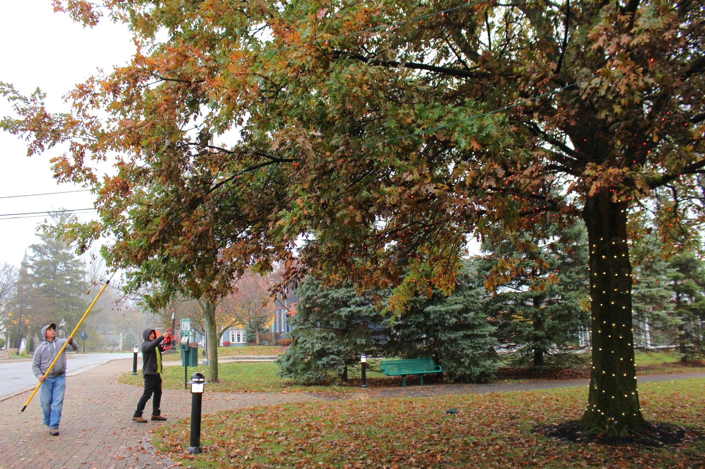
Satisfaction with City
Services and Amenities

Slide 16
  ..
  ..
Six out of ten residents are very satisfied with city-sponsored events …
… a slight drop from 2023.
City-Sponsored Events
62%
2025
2025
94%
Very satisfied
62%
2023
72%
2023
96%
2021
2021
93%
94%
2018
89%
2018
2016
2016
91%
Somewhat
satisfied
32%
2014
2014
90%
2012
2012
94%
2010
93%
2010
2008
Somewhat
dissatisfied
5%
2008
94%
Not
sure
1%
0%
25%
50%
75%
100%
Very dissatisfied
0%
Somewhat satisfied
Very satisfied
Q8(b): As a resident of Powell, how satisfied are you with each of the following?
16

Slide 17
  .
Six out of ten residents also are very satisfied with the city’s commitment to removing snow …
… up from 2023.
Six out of ten residents
Snow Removal
2025
92%
2025
Very satisfied
63%
2023
2023
85%
Somewhat
satisfied
29%
2021
92%
2021
88%
2018
2018
91%
2016
2016
89%
2014
2014
93%
2012
2012
94%
Somewhat
dissatisfied
6%
2010
2010
90%
2008
2008
90%
Very
dissatisfied
1%
0%
25%
50%
75%
100%
Not sure
1%
Somewhat satisfied
Very satisfied
Q8(f): As a resident of Powell, how satisfied are you with each of the following?
17

Slide 18
  .
Most residents are satisfied, as well, with Powell’s parks and open spaces ...
… though fewer were very satisfied compared to past years.
City’s Parks / Open Spaces
2025
49%
2025
88%
Very satisfied
49%
2023
2023
59%
91%
Somewhat
satisfied
39%
2021
64%
2021
89%
88%
2018
86%
2018
2016
2016
94%
2014
2014
92%
2012
2012
92%
2010
2010
86%
Not sure
1%
2008
2008
91%
Very
dissatisfied
1%
Somewhat
dissatisfied
10%
0%
25%
50%
75%
100%
Somewhat satisfied
Very satisfied
Q8(c): As a resident of Powell, how satisfied are you with each of the following?
18

Slide 19
  .
Nearly nine out of ten residents are also satisfied with Powell’s parks and
recreation programming, as they have been in years past.
Parks and Rec Programming
2025
2025
87%
Very satisfied
50%
2023
2023
87%
Somewhat
satisfied
37%
2021
2021
89%
87%
2018
85%
2018
2016
2016
85%
2014
2014
84%
2012
2012
87%
2010
2010
87%
Not sure
3%
2008
2008
83%
0%
25%
50%
75%
100%
Very dissatisfied
3%
Somewhat dissatisfied
7%
Somewhat satisfied
Very satisfied
Q8(d): As a resident of Powell, how satisfied are you with each of the following?
19

Slide 20
In short, most residents are satisfied with the services and
amenities the city provides.
Very and Somewhat Satisfied with City-Managed Services and Amenities
94%
92%
88%
87%
City-sponsored
events
Snow removal
Parks / open spaces
Parks / rec
programs
Sorted from most to least satisfied
Q8(b-d, and f): As a resident of Powell, how satisfied are you with each of the following?
20

Slide 21

Satisfaction with City Officials:
Managing and Planning

Slide 22
  ..
One resident in five has a “great deal” of trust and confidence in city officials.
Little has changed since 2021.
Trust and Confidence
2025
82%
2025
2023
2023
81%
A great deal
19%
Fair amount
63%
2021
2021
80%
82%
2018
-
Not sure
2%
2016
-
None
at all
3%
2014
-
2012
-
2010
-
Not very much
13%
2008
-
0%
25%
50%
75%
100%
Fair amount
A great deal
Q10: How much trust and confidence do you have in Powell’s city officials when it comes to handling important local issues?
22

Slide 23
  .
Though most residents are satisfied with Powell’s city council,
only one in five is very satisfied.
That said, satisfaction, overall, has never been higher.
Powell City Council
2025
2025
77%
2023
Very satisfied
22%
2023
73%
Somewhat
satisfied
55%
2021
77%
2021
75%
2018
2018
66%
2016
Not sure
8%
2016
65%
2014
2014
69%
Very
dissatisfied
2%
2012
2012
72%
2010
2010
66%
Somewhat
dissatisfied
13%
2008
2008
64%
0%
25%
50%
75%
100%
Somewhat satisfied
Very satisfied
Q8(e): As a resident of Powell, how satisfied are you with each of the following?
23

Slide 24
Three out of four residents are satisfied with city-sponsored economic development activities, but only one in five is very satisfied.
City-Sponsored Economic Development Activities*
2025
2025
76%
Very satisfied
18%
2023
-
Somewhat
satisfied
58%
2021
-
76%
2018
-
2016
-
Not sure
11%
2014
-
2012
-
Very
dissatisfied
2%
-
2010
2008
-
Somewhat
dissatisfied
11%
0%
25%
50%
75%
100%
Somewhat satisfied
Very satisfied
*New in 2025
Q8(g): As a resident of Powell, how satisfied are you with each of the following?
24

Slide 25
  ..
Three out of four residents are satisfied with the efforts of city
officials to keep them informed …
… down slightly from previous years.
Keeping Residents Informed
2025
75%
2025
2023
Very satisfied
28%
2023
80%
Somewhat
satisfied
47%
2021
2021
80%
75%
2018
82%
2018
2016
2016
83%
Not sure
2%
2014
2014
76%
2012
Very
dissatisfied
4%
2012
85%
2010
-
2008
-
Somewhat
dissatisfied
19%
0%
25%
50%
75%
100%
Somewhat satisfied
Very satisfied
Q9(e): How satisfied are you with the overall performance of city officials in each of these areas?
25

Slide 26
  .
Satisfaction with the city’s efforts to revitalize downtown, though high …
… has declined modestly since 2021.
Revitalizing Downtown
2025
2025
72%
2023
Very satisfied
24%
2023
78%
Somewhat
satisfied
48%
2021
2021
84%
72%
2018
2018
73%
2016
2016
73%
2014
2014
81%
2012
Not sure
1%
2012
86%
2010
74%
2010
Very
dissatisfied
7%
2008
2008
83%
Somewhat
dissatisfied
20%
0%
25%
50%
75%
100%
Somewhat satisfied
Very satisfied
Q9(d): How satisfied are you with the overall performance of city officials in each of these areas?
26

Slide 27
  ..
  .
Seven out of ten residents are satisfied with how city officials
manage Powell’s finances …
… down from 2021 and 2023.
Managing City Finances
2025
2025
72%
2023
Very satisfied
24%
2023
82%
Somewhat
satisfied
48%
2021
2021
78%
72%
2018
2018
60%
2016
2016
74%
2014
Not sure
7%
2014
77%
2012
2012
70%
Very
dissatisfied
3%
2010
2010
70%
2008
2008
62%
Somewhat
dissatisfied
18%
0%
25%
50%
75%
100%
Somewhat satisfied
Very satisfied
Q9(g): How satisfied are you with the overall performance of city officials in each of these areas?
27

Slide 28
  ..
Seven out of ten residents believe that city officials listen
to their concerns, down slightly from 2021.
Listening to Concerns of Residents
2025
2025
69%
2023
Very satisfied
23%
2023
75%
Somewhat
satisfied
46%
2021
2021
76%
69%
2018
73%
2018
2016
2016
66%
Not sure
6%
2014
2014
69%
2012
2012
73%
Very
dissatisfied
5%
2010
67%
2010
2008
2008
60%
Somewhat
dissatisfied
20%
0%
25%
50%
75%
100%
Somewhat satisfied
Very satisfied
Q9(h): How satisfied are you with the overall performance of city officials in each of these areas?
28

Slide 29
  .
A similar figure are satisfied with how city officials respond to their concerns.
Responding to the
Concerns of Residents*
2025
2025
67%
Very satisfied
18%
2023
-
Listening
to the concerns
of local residents:
69%.
Somewhat
satisfied
49%
2021
-
67%
2018
-
2016
-
Not sure
6%
2014
-
2012
-
Very
dissatisfied
8%
2010
-
2008
-
Somewhat
dissatisfied
19%
0%
25%
50%
75%
100%
Somewhat satisfied
Very satisfied
*New in 2025
Q9(i): How satisfied are you with the overall performance of city officials in each of these areas?
29
Notes:
SS up from 41% in 2018 …

Slide 30
  ..
As in years past, seven out of ten residents are satisfied with how city officials plan for the future.
Planning for the Future
2025
69%
2025
2023
Very satisfied
20%
2023
71%
Somewhat
satisfied
49%
2021
2021
72%
69%
2018
2018
71%
Not sure
4%
2016
2016
69%
Very
dissatisfied
4%
2014
2014
67%
2012
2012
72%
2010
71%
2010
2008
Somewhat
dissatisfied
23%
2008
66%
0%
25%
50%
75%
100%
Somewhat satisfied
Very satisfied
Q9(a): How satisfied are you with the overall performance of city officials in each of these areas?
30

Slide 31
Seven out of ten residents are satisfied with how city
officials attract commercial growth.
Attracting Commercial Growth*
2025
2025
69%
Very satisfied
19%
2023
-
Somewhat
satisfied
50%
2021
-
69%
2018
-
Not sure
2%
2016
-
Very
dissatisfied
7%
2014
-
2012
-
2010
-
2008
-
Somewhat
dissatisfied
22%
0%
25%
50%
75%
100%
Somewhat satisfied
Very satisfied
*New in 2025
Q9(c): How satisfied are you with the overall performance of city officials in each of these areas?
31

Slide 32
Seven out of ten residents are satisfied with how city officials process permits for home additions, significant remodeling, and required inspections.
Processing Permits*
2025
2025
68%
Very satisfied
24%
2023
-
Somewhat
satisfied
44%
2021
-
68%
2018
-
2016
-
Not sure
18%
2014
-
2012
-
2010
-
Very
dissatisfied
4%
2008
-
0%
25%
50%
75%
100%
Somewhat dissatisfied
10%
Somewhat satisfied
Very satisfied
*New in 2025
Q9(b): How satisfied are you with the overall performance of city officials in each of these areas?
32

Slide 33
  ..
Only one resident in two is satisfied with how city officials have managed the flow of traffic through Powell …
… down significantly from 2021.
Managing Traffic
2025
54%
2025
2023
Very satisfied
13%
2023
62%
Somewhat
satisfied
41%
2021
2021
74%
54%
Not sure
<1%
2018
2018
56%
2016
2016
34%
Very
dissatisfied
13%
2014
2014
35%
2012
2012
45%
2010
45%
2010
2008
2008
43%
Somewhat
dissatisfied
32%
0%
25%
50%
75%
100%
Somewhat satisfied
Very satisfied
Q9(f): How satisfied are you with the overall performance of city officials in each of these areas?
33
Notes:
SS up from 41% in 2018 …

Slide 34
Though most residents are satisfied with how city officials manage and plan
on the community’s behalf, managing traffic remains an issue.
Very or Somewhat Satisfied with City Officials: Managing and Planning
77%
76%
75%
72%
72%
69%
69%
69%
68%
67%
54%
City
council
City-sponsored
activities*
Keeping
residents
informed
Revitalizing
downtown
Managing
city finances
Listening to
residents
Planning
for the future
Attracting commercial growth*
Processing permits*
Responding
to concerns*
Managing traffic
Sorted from most to least satisfied
*New in 2025
Q8(e and g), Q9(a-f and i): How satisfied are you with the overall performance of city officials in each of these areas?
34

Slide 35

Downtown Powell

Slide 36
  ..
According to six out of ten residents, downtown Powell has changed for the better over the past few years, down from three out of four in 2023.
Downtown Powell
2025
63%
2025
Much better
18%
2023
2023
74%
2021
2021
71%
63%
2018
Somewhat
better
45%
2018
65%
2016
2016
62%
2014
-
2012
-
Not sure
25%
-
2010
2008
-
0%
25%
50%
75%
100%
Much worse
3%
Somewhat worse
9%
Somewhat better
Much better
Q12: Over the past few years, has downtown Powell changed for the better, changed for the worse, or can’t you say? And, is that much (better / worse)?
36

Slide 37
  ..
For a plurality of residents, the highest priority for downtown Powell (among several suggested) is a broader assortment of restaurants.
“High” Priority
Broader assortment of restaurants, including
specialty food shops
2025
2023
36%
58%
51%
More pedestrian-friendly features
23%
59%
70%
More parking
22%
56%
58%
More businesses offering family-friendly
entertainment
11%
36%*
-
Indoor performance venue
5%
25%*
-
Shuttles to and from parking lots
at the edge of downtown
1%
11%*
-
Valet parking
1%
7%*
-
Highest priority
*New in 2025
Q15: Which of these would you make your highest priority?
37
/ Q14: For each of the following suggestions, tell me if you would make it a high, medium, or low priority for downtown Powell.

Slide 38
Eight out of ten residents have attended at least one event in downtown Powell over the past year. Five out of ten have attended more than one event.
Attended Event Downtown*
2025
2025
79%
Yes, one
event
29%
2023
-
Yes, more
than one
50%
2021
-
79%
2018
-
2016
-
2014
-
2012
-
2010
-
2008
-
No
21%
0%
25%
50%
75%
100%
More than one event
One event
*New in 2025
Q13: In the past year, have you attended an event downtown sponsored by either Visit Powell or City of Powell? And, was that one event or more than one?
38
Notes:
SS up from 41% in 2018 …

Slide 39
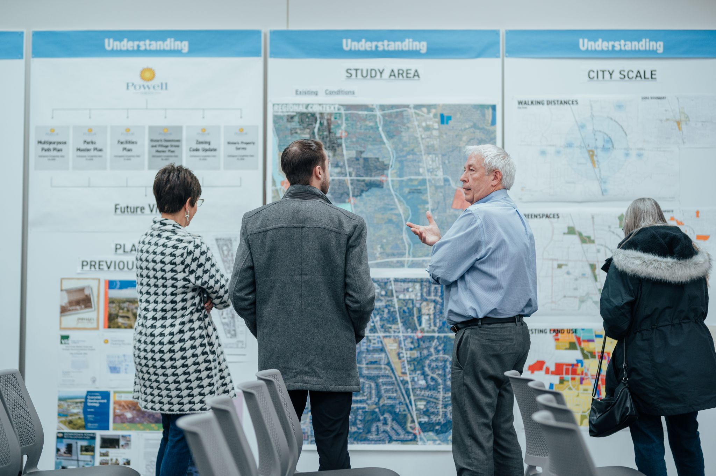
Looking Ahead

Slide 40
  …
When residents identified issues, concerns, and problems (unaided) local officials should consider their highest priorities, managing the flow of traffic within Powell was mentioned most often.
Since 2023
Managing the flow of traffic within Powell
37%
(+5 pp)
Lowering taxes / keeping taxes low
18%
(+7 pp)
Encouraging growth (e.g., more businesses, affordable
housing, commercial development)
18%
(+2 pp)
Maintaining or repairing infrastructure
15%
(-3 pp)
Controlling growth, residential and / or commercial
13%
(-2 pp)
Keeping the city safe / having enough police officers
13%
(-9 pp)
Highest priority
Q4: When you think of issues, concerns, or problems facing the City of Powell, what should your local city officials consider their two or three highest priorities? (open-ended question)
40

Slide 41
When residents were asked what Powell needs more of,
dozens of suggestions were offered.
Q11: As you look ahead, say, three to five years from now, what would you like to see more of in Powell? (open-ended question)
41

Slide 42
“
What would you like to see more of in Powell?
Development while keeping the old-town feel. Like old Dublin or old Worthington.
No
through
traffic
in
downtown.
More road improvements …
traffic control, and less speeding.
Limits to new resident construction.
More locally-owned
restaurants.
I would love an actual rec center with indoor and outdoor pools. Tired of giving my money to Dublin.
I am concerned with how our community looks. I compare us to Dublin and their city planning, landscaping, and business upkeep is far superior. For the amount of taxes we pay, I expect more.
Fine dining.
Connectivity of bike trails. Walkability. Ease of pedestrian traffic. Ability to get to one place from another without having a car.
Don’t develop every piece of land.
More commercial growth that supports the tax base.
More city-planned
activities downtown.
“
Better options for downtown parking.
ADDITIONAL COMMENTS APPEAR IN A SEPARATE DOCUMENT
42

Slide 43
“
What would you like to see more of in Powell? (cont’d)
Better traffic, safety, green space, and bike path connections. Getting good commercial business but not ruining the small-town feel.
Street maintenance improvements:
curb and sidewalk repair … addressing safety issues immediately,
such as large potholes.
Lively patios, entertainment options, and foot traffic from the farm all the way to Handel’s, and the Powell library all the way to Adventure Park.
What development can be done to support larger businesses
like Dublin has?
They haven’t zoned
most of their land residential like Powell keeps doing.
If I look at the difference between Dublin and here,
it’s serious in terms of how much more they have invested in their bike and pedestrian mobility.
We can do a better job in that.
… less businesses like insurance … better parking.
I would like to see … more things to do for people of all ages, not just small children.
More green areas, undeveloped. Passive parks with trails and .... More walkability.
Buildings that
at least look historic.
“
Better infrastructure.
ADDITIONAL COMMENTS APPEAR IN A SEPARATE DOCUMENT
43

Slide 44
  ..
Choosing from six “capital improvements” the city has identified, predictably, a plurality of residents consider improving the flow of traffic their highest priority.
“High” Priority
2025*
Easing traffic congestion
37%
71%
Improving downtown
19%
54%
Building a facility for health, recreation,
or entertainment
15%
35%
Improving and expanding bike paths
14%
44%
Parking
10%
47%
Improving and expanding parks
5%
42%
Highest priority
*New in 2025
Q19: Which of these services should the city make its highest priority?
44
/ Q18: As I mention each [capital improvement] in Powell …. tell me if the city should make it a high, medium, or low priority.

Slide 45
  ...
Choosing from five city services, opinions were split on which one the city should consider its highest priority.
A plurality of residents considered snow removal a high priority.
“High” Priority
2025*
Street leaf pick-up in residential areas
24%
31%
Removing snow from commercial
sidewalks and bike paths
23%
38%
Adding more police
22%
21%
Disposal of hazardous waste materials
(i.e., discarded car batteries)
18%
31%
Disposal of biodegradable waste
(i.e., discarded food)
12%
23%
Highest priority
*New in 2025
Q17: Which of these would you make your highest priority?
45
/ Q16: These next few questions deal with city services in Powell …. tell me if the city should make it a high, medium, or low priority.

Slide 46
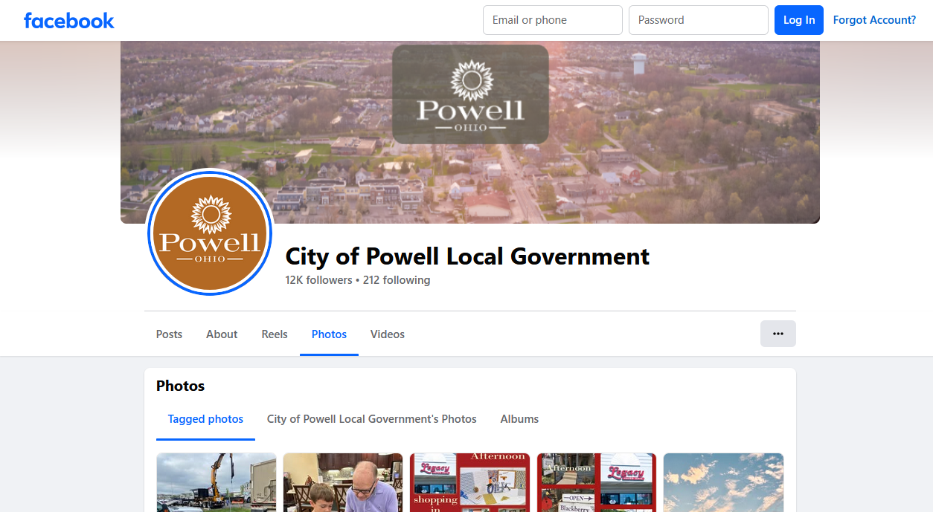
Communication

Slide 47
  ..
Six out of ten Powell residents follow the city on social media, up from five out of ten in 2023. The most common followers are women, residents 35 to 54, and households with children. The most popular platform, by far, is Facebook.
Follow Powell on Social Media
Facebook
89%
Yes
58%
Instagram
24%
2023: 48%
Nextdoor
8%
Follow Powell
55% Male
61% Female
64% ≤ 34 yrs
72% 35 to 54 yrs
43% ≥55 yrs
70% Children
41% No children
X (Twitter)
5%
No
42%
LinkedIn
4%
Powell Bubble
1%
64% Right direction
42% Wrong track
0%
25%
50%
75%
100%
Follows Powell on social media platform
/ Q31: On which social media platform – or platforms – do you follow Powell?
47
Q30: Do you follow Powell on social media?
Notes:
There is no direct comparison from 2018 for this question.

Slide 48
  ..
For a plurality of residents, the city’s social media is the primary
source of news and information about Powell.
Overall, digital sources dominate.
Since 2023
Powell’s social media
50%
(+8 pp)
Powell’s website
32%
(+5 pp)
Mailings from the city
(Powell’s quarterly newsletter)
27%
(+2 pp)
Powell’s weekly e-newsletter
22%
(-4 pp)
Columbus Dispatch, online
5%
(+2 pp)
Internet, not specified
5%
(+3 pp)
Most common source of Powell news / info
Q29: Other than friends and family, where do you get most of your news and information about Powell? (open-ended question)
48

Slide 49
  …
Nearly half of Powell’s residents visited the city’s website over the
past three months …
… down slightly from 2023.
Visited City’s Website in Last 3 Months
Yes
47%
2023: 50%
Most visitors
(75%) easily found
the information
they sought.
2023: 86%
The content sought
most often involves
city events (26%),
parks and recreation (15%),
city council (14%),
development plans (13%),
and city services (6%).
City events
2023: 46%
No
53%
Q32: Have you been to the city’s website during the past three months? / Q33: The last time you visited the city’s website, why did you go – in other words, what were you looking for? Was it easy or difficult to find?
49

Slide 50
  ...
Two out of three residents consider the city’s website either better than average or exceptional, as they did in 2023.
City Website Rating
2025
Exceptional /
Better than
average
61% Phone
70% Online
66% Emp. FT
44% Hmkr.
69% Retired
60% Kids
74% No kids
72% Men
61% Women
2025
2025
66%
2023
67%
Exceptional
8%
2023
2021
66%
2021
51%
Disappointing
2%
Better than
average
58%
2018
2018
59%
2016
2016
58%
2014
2014
61%
2012
Just okay
32%
2012
60%
2010
59%
2010
2008
2008
56%
0%
25%
50%
75%
100%
Better than average
Exceptional
Q34: Overall, is the city’s website exceptional, better than average, just okay, or disappointing?
50

Slide 51

Key Findings

Slide 52
  ....
  As in surveys dating to 2008, most residents consider Powell, as a place to live, either better than average (51%) or exceptional (44%).
  Once again, most residents (77%) also believe that Powell is heading in the right direction.
  For a plurality of residents, being a “safe community” is Powell’s most ap-pealing attribute (34%), replacing “small-town atmosphere” (20%).
  Predictably, the Powell Police Department is highly regarded (97%), as it has been for years.
  Most residents also are satisfied with Powell’s city-sponsored events (94%), snow removal (92%), parks, open spaces, and bike paths (88%), and parks and recreation programming (87%).
52

Slide 53

  ...
  As in previous surveys, a majority of residents (82%) have trust and confidence in city officials. Impressions of City Council, specifically, are almost equally positive (77%).
  In one area – managing the flow of traffic within Powell – satisfaction is significantly lower (54%). Moreover, a plurality of residents consider this issue a top priority.
  Fewer residents today, compared with 2023, feel that downtown Powell has changed for the better (63% v. 74%). To improve downtown, a plurality of residents (36%) spoke of the need for a broader assortment of restaurants.
  Social media is the most common source of information about Powell (50%) followed by the city’s website (32%).
53

Slide 54
  Questions?
54

Slide 55
  This research was conducted by
  Saperstein Associates, Inc.
  4942 Reed Road
  Columbus, Ohio 43220
  (614) 261-0065

